Slide 1
Advolition
Issue #61: Generating Random Arenas
10 March -

Slide 2
Tournament Robotics
Notes:
I have a goal of creating miniature robotics tournaments to teach students how to program.

Slide 3
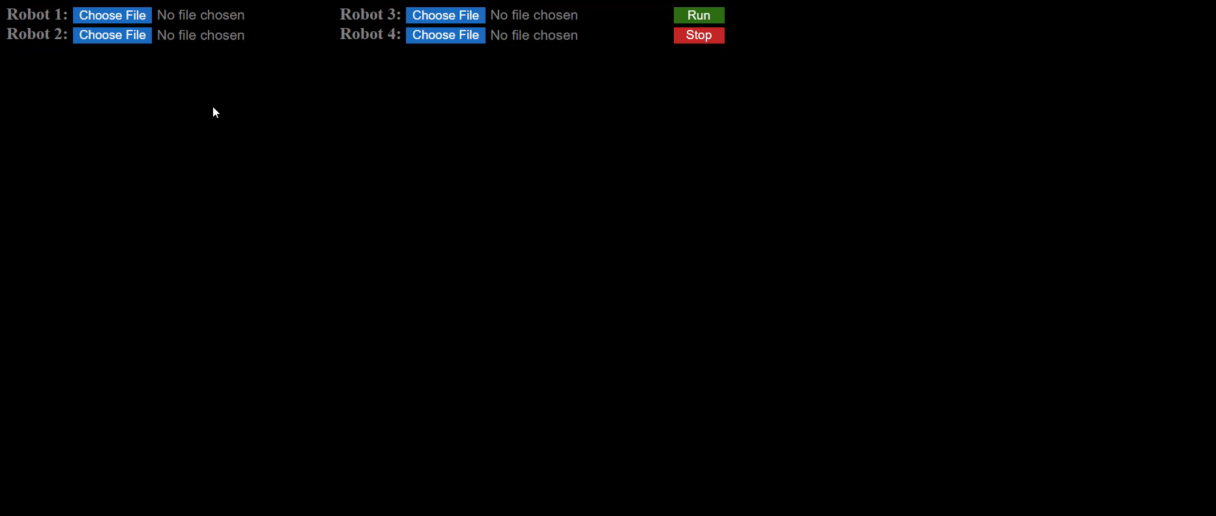
Advolition
Notes:
Advolition is a tournament environment that I’m creating in Java Script
The browser-based game allows 1-4 players to upload code for robots to explore a Roguelike dungeon and battle other robots along the way.

Slide 4
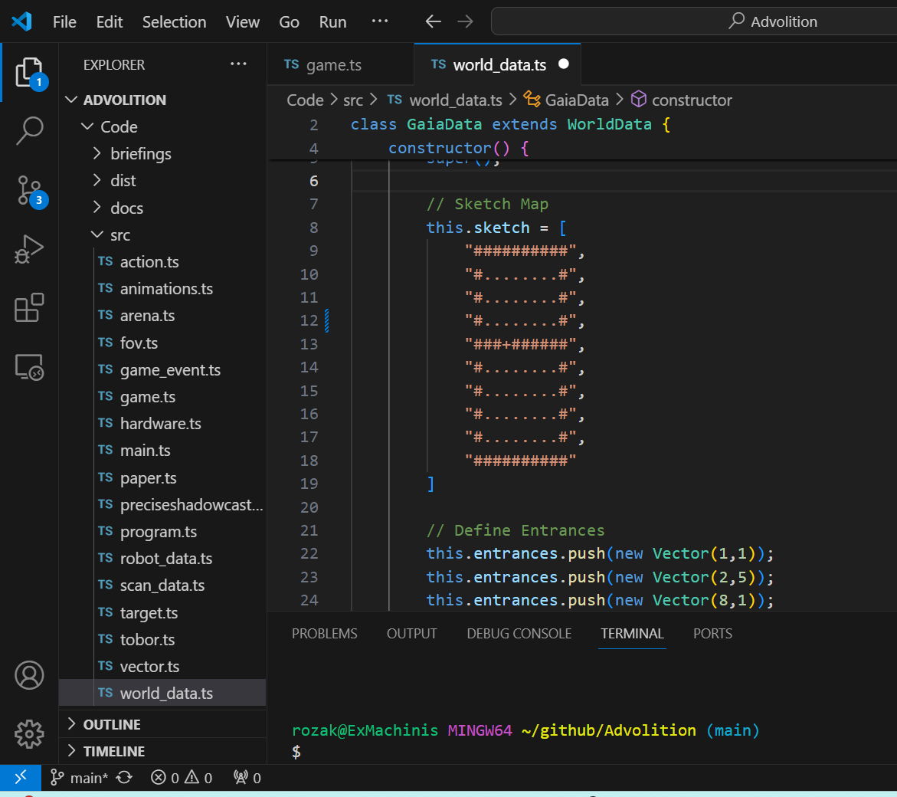
Arena Generation
Notes:
In its current state, Advolition pulls uses a simple, manually designed dungeon, which I created mainly for testing purposes.
However, I’d like to have generate a random dungeon each time the player restarts the game.

Slide 5
Solution

